Slide 1

Inventory Management System for Anemos Energies
Prepared By:
Abdullah Shaikh 191106001
Aslan Shaikh 191106009
Joseph Roy Thayil 191106023

Slide 2
Agenda
Introduction about company.
Overview of Inventory Management System.
Problem statement.
Purpose of the project.
Research papers.
Proposed solutions.
Algorithms
Conclusion.

Slide 3
INTRODUCTION ABOUT COMPANY

Slide 4
Problem statement
Problem Statement: The manual process of managing inventory is becoming increasingly difficult and inefficient in today's fast-paced business environment. This leads to a number of challenges, including:
Inaccurate tracking of inventory levels
Increased costs due to overstocking or stock shortages
Poor customer satisfaction due to unavailability of products
Time-consuming manual processes
Inability to make informed decisions about inventory levels and reordering
Lack of real-time data on stock levels and demand patterns
These challenges highlight the need for a more efficient and automated solution for inventory management.

Slide 5
Introduction
Inventory Management System developed using Flutter and Android Studio
Uses Nodejs and Expressjs for backend
Objective: comprehensive overview of organization's stock
Intranet-based, with admin component to manage inventory
Includes organization profile, sales, purchase, and stock details
Real-time information on stock balance and transactions
Stock updated based on transactions or returned sales.
Login page for secure management of stock.
Designed for Anemos Energies Goa with actors: admin, operator, vendor
Each actor with specific rights and access levels.

Slide 6
Modules

Slide 7
Modules
Admin Module
Operator Module.
QR Code System Module
Forecasting Module
Reports Module
User Management Module.
Image classification

Slide 8
Login module
Purpose: The Login Module is responsible for authenticating and authorizing the actors in the system.
Access Control: The module implements access control to ensure only authorized actors can access the system's features.
User Authentication: The module handles user authentication, verifying the user's identity before allowing access to the system.
Actor Management: The module manages the different actors in the system, including the admin, operator, and vendor, and assigns specific rights and access levels.
Secure Login: The module implements a secure login process to protect the organization's stock and prevent unauthorized access.
User Session Management: The module handles the management of user sessions, including the creation and termination of sessions as needed.

Slide 9
Admin module
Purpose: The Admin Module is responsible for managing and controlling the inventory within the organization.
Inventory Management: The module manages the overall inventory, including adding, updating, and deleting inventory items.
Stock Overview: The module provides a comprehensive overview of the organization's stock, including real-time information on the remaining balance of stock and transaction details.
User Activity Tracking: The module tracks the activities of the operator, including all operations that modify the database records, for auditing purposes.
Reporting: The module provides reporting on the sales, purchases, and remaining inventory, including the auditing system for transparency.
User Management: The module manages the actors in the system, including assigning rights and access levels.
Vendor Management.

Slide 10
QR CODE:
QR code system for quick retrieval of item information
QR code generated after operator adds item details
QR code can be printed and attached to box
Scanning QR code displays item details in system
Allows operator to make modifications as needed
QR code generation
Store Item details
QR code scanning
Get item details
QR code can be printed and attached to box.
Advantages:
Efficient method to store item details
Get item details quickly
Secure

Slide 11
Algorithm

Slide 12
Image classification
Identifying items directly using its image.
Quick fetching and updation.
Image classification will be done on client side (phone).
Advantages:
Reduction in operational time
Consistent item names in database
No need to type
No need to remember exact item names
Helpful for illiterate workers.

Slide 14
BLOCK DIAGRAM FOR QR CODE SCANNING
No
Send error message
Found QR Code?
Capture Image
Process Image
Process the QR code
Image
Yes
Display Item Details
Format the data
Get output text

Slide 15

Research Papers
A Review of QR code Structure for Encryption
and Decryption Process
International Journal of Innovative Science and Research Technology ISSN No: - 2456- 2165
Key-points:
2-dimensional barcode.
4296 alphanumeric characters.
Read by optical device with the appropriate software
Example: QR code reader, mobile phones.
Link: - https://ijisrt.com/wp-content/uploads/2017/03/A-Review-of-QR-code-Structure-for-Encryption-and-Decryption-Process.pdf

Slide 16

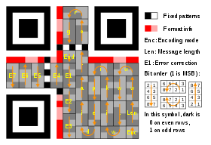

Feasibility study
QR code generation and scanning API:
https://developers.google.com/chart/infographics/docs/qr_codes
Deprecated
https://goqr.me/api/
API call
https://api.qrserver.com/v1/create-qr-code/?size=150x150&data={nuts: 400; bolts: 300; washers: 400; generator: 20 }
QR code structure

Slide 17
BLOCK DIAGRAM FOR IMAGE CLASSIFICATION
Capture Image
Process Image
Send Image to ML Model
Get Item ID
Image
Display Item Details
Fetch Data from database using Item ID

Slide 18
A SURVEY ON IMAGE CLASSIFICATION APPLICATION TECHNIQUES
Kamavisdar, Saluja & Agrawal (2013)
PURPOSE:
Multiple dataset that being located under each of Hierarchical classifier.
Rejection of the class on the intermediary stage.
METHOD USED:
Decision Tree
RESULT:
Considered very simple and high rate of efficiency.
Link:-
https://www.researchgate.net/publication/269984702_A_survey_of_image_classification_methods_and_techniques

Slide 19
FAST IMAGE CLASSIFICATION BY BOOSTING FUZZY CLASSIFIERS
Korytkowski, Rutkowski & Scherer (2016)
PURPOSE:
Simple boosting Meta knowledge where local characteristic can be mostly formed.
METHOD USED:
Fuzzy Classifiers
RESULT:
Learning and classification is very fast although accuracy is not up to the mark.
Link:-
https://www.researchgate.net/publication/282175413_Fast_Image_Classification_
by_Boosting_Fuzzy_Classifiers

Slide 20

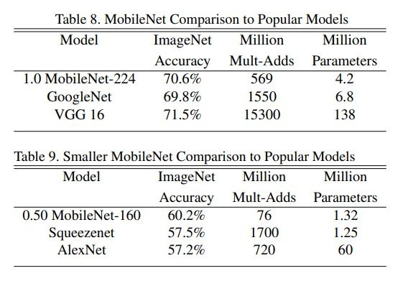

MobileNets: Efficient Convolutional Neural Networks for Mobile Vision Applications Google Inc.
It is more accurate than GoogleNet while being smaller and more than 2.5 times less computation.
MobileNet is nearly as accurate as VGG16 while being 32 times smaller and 27 times less compute intensive.
Table 9 compares a reduced MobileNet with reduced resolution 160 × 160.
ReducedMobileNet is 4% better than AlexNet while being 45×smaller and 9.4× less compute than AlexNet.
It is also 4%better than Squeezenet at about the same size and 22×less computation.

Slide 21
Convolutional Neural Network (CNN)
Advantages:
CNNs do not require human supervision for the task of identifying important features.
They are very accurate at image recognition and classification.
Weight sharing is another major advantage of CNNs.
Convolutional neural networks also minimize computation in comparison with a regular neural network.
CNNs make use of the same knowledge across all image locations

Slide 22
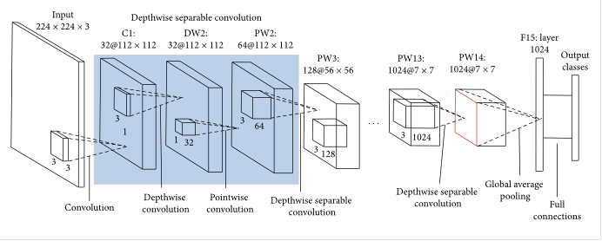
Mobilenet
MobileNet uses a Convolutional Neural Network (CNN) architecture model.
lightweight making it more suitable for embedded systems and mobile devices.
MobileNetV2 significantly reduces the number of parameters thus making it less complex.
Architecture of MobileNetV2 model:

Slide 23
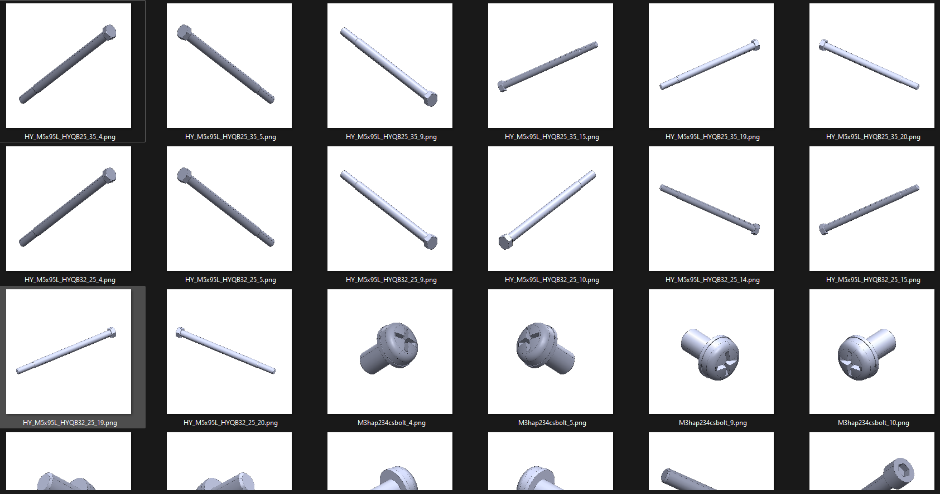
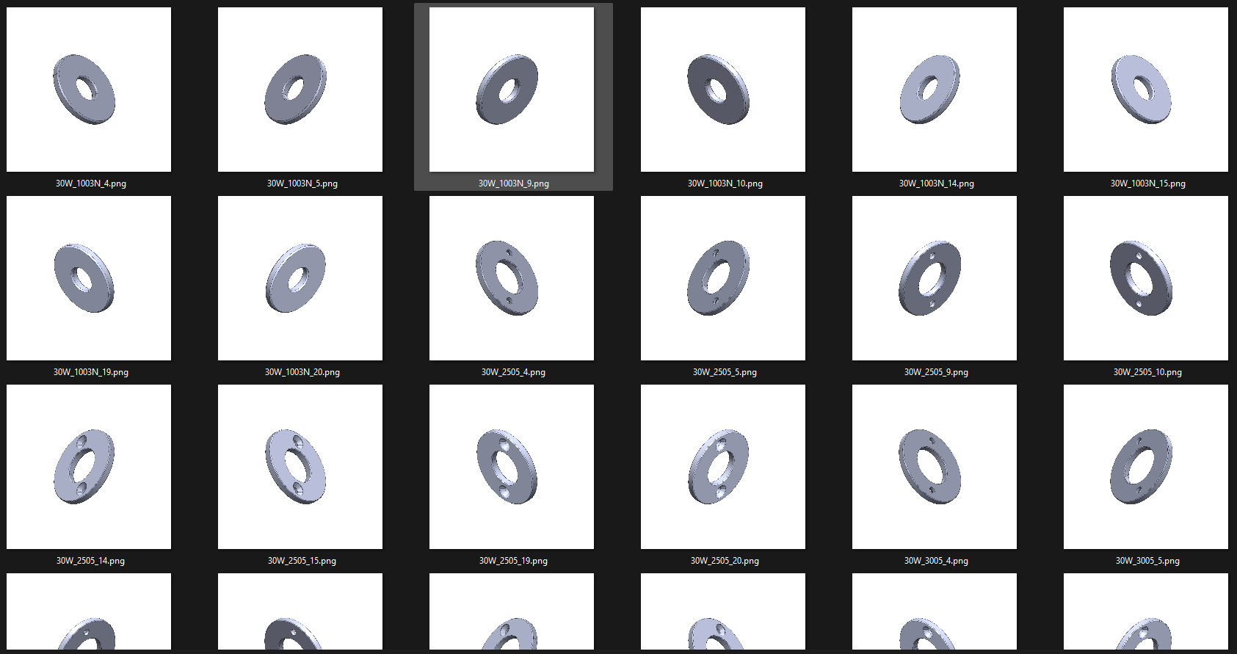
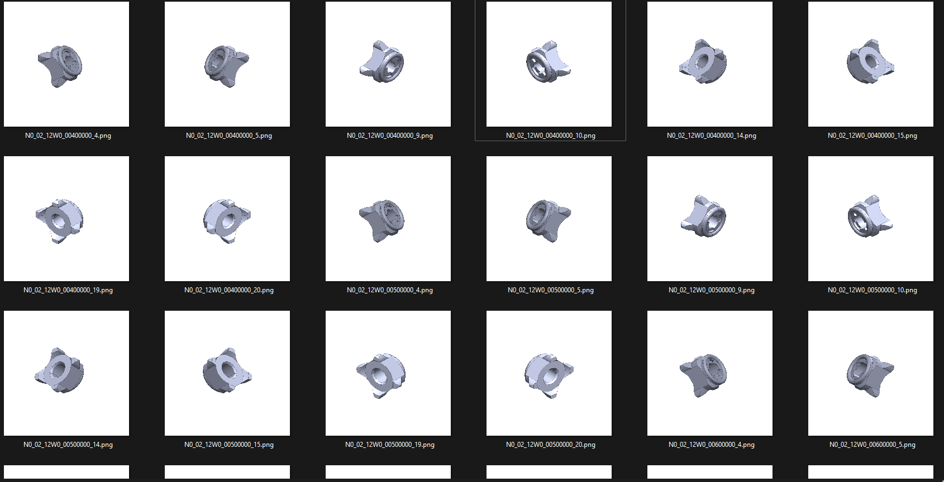
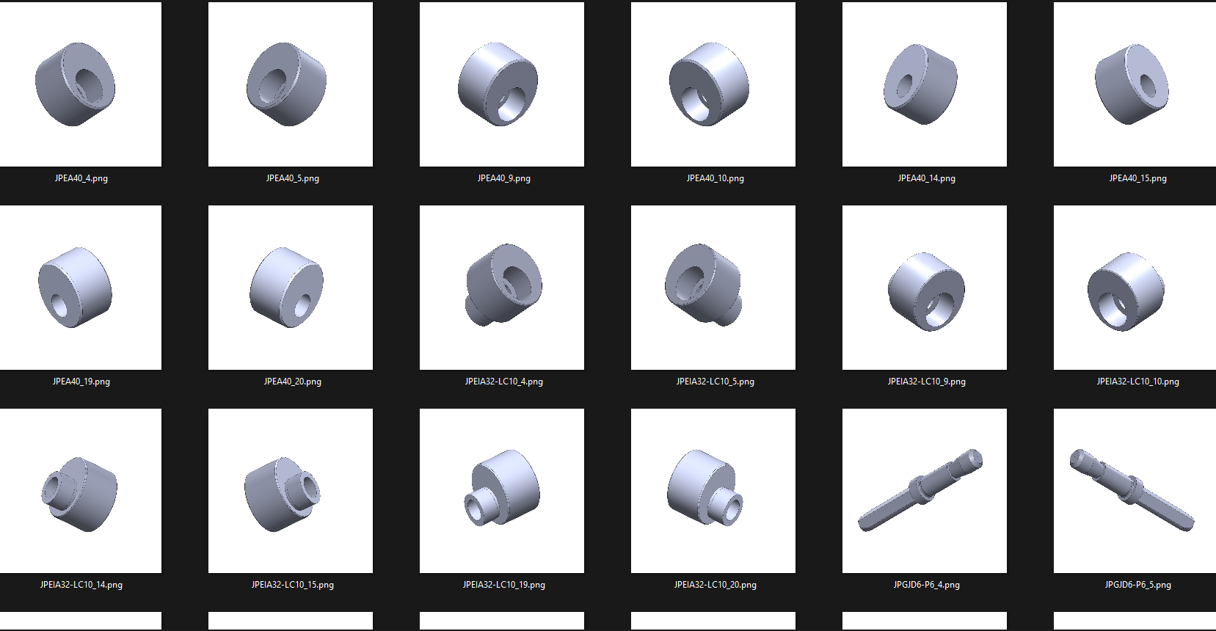
Datasets
Sources:
DATASET - Images of mechanical parts (Bolt, Nut, Washer, Pin) https://www.kaggle.com/datasets/manikantanrnair/images-of-mechanical-parts-boltnut-washerpin
Bolts
Washer
Nuts
Locating Pin

Slide 24
Feasibility study:
Tensorflow lite models in flutter
deprecated
Google ml kit module in flutter
Custom model
Classifies more than 400+ objects.
Hence larger in size.

Slide 25
Work done from pr-1 to pr-2
Decided the source of dataset.
Feasibility study of existing algorithms
WEEK 3
WEEK 1
WEEK 2
Referred research papers on image classification
Literature survey for QR code.

Slide 26
POWER PREDICTION

Slide 27
Working
User need to share his location.
Prediction of future Wind speed.
Based on that, power output will be calculated.
beneficial or not?
Relationship of wind speed with turbine power:
2 types of turbine
Wind speed | Large Turbine | Small Turbine
5 m/s | 2 kw/hr | 1 kw/hr
10 m/s | 4.5 kw/hr | 2 kw/hr

Slide 28
Thank you

